Slide 1


Green Pace
Security Policy Presentation
Developer: Angela Karina Vegega Ortiz
Notes:
This is the Green Pace Security Policy Presentation by Developer: Angela Karina Vegega Ortiz

Slide 2

OVERVIEW: DEFENSE IN DEPTH
The purpose of this security policy is to standardize coding security best practices across all projects.
This will ensure consistency as the team grows.
It will streamline onboarding for new developers and reduce vulnerabilities.
It covers 10 core security principles, coding standards, and examples of compliant and non-compliant code.
Each standard adds a layer of protection to mitigate both high and low-level risks.
Notes:
Our team has already been using secure coding habits informally but inconsistently. Implementing a standardized security policy ensures that every developer, new or experienced, applies the same principles, understands the threat levels and risks, and knows how to prevent vulnerabilities. By following the 10 core security principles and detailed coding standards, we will create multiple layers of defense, or Defense in Depth, to protect our systems from potential threats.

Slide 3
THREATS MATRIX
Likely STD-002-CPP Ensure that division and remainder operations do not result in divide-by-zero errors STD-003-CPP Guarantee that storage for strings has sufficient space for character data and the null terminator STD-004-CPP Exclude user input from format strings STD-005-CPP Detect and handle memory allocation errors STD-007-CPP Handle all exceptions | Priority STD-004-CPP Exclude user input from format strings STD-005-CPP Detect and handle memory allocation errors STD-008-CPP Do not define a C-style variadic function
Low priority STD-001-CPP Never qualify a reference type with const or volatile STD-006-CPP Use a static assertion to test the value of a constant expression STD-009-CPP Do not use std::rand() for generating pseudorandom numbers STD-010-CPP Do not abruptly terminate the program | Unlikely STD-001-CPP Never qualify a reference type with const or volatile STD-006-CPP Use a static assertion to test the value of a constant expression STD-009-CPP Do not use std::rand() for generating pseudorandom numbers
Notes:
The threats matrix has four quadrants: Likely, Priority, Low priority, and Unlikely. It has been populated with the 10 coding standards in our policy.
Standards in the Likely quadrant are those that are likely to introduce vulnerabilities if not followed, like divide-by-zero errors from unchecked division and remainder operations.
The Unlikely quadrant contains standards with a low probability of introducing vulnerabilities.
Low priority standards are those unlikely to introduce severe vulnerabilities and may not be easily detected by automation, like not using a static assertion to test the value of a constant expression. These can take time to manually find and repair, time that could be used to repair more critical flaws.
Priority standards are likely to introduce severe vulnerabilities and should be dealt with first, as they can often be found by automated tools such as Cppcheck. For example, STD-004-CPP (Exclude user input from format strings) and STD-005-CPP (Detect and handle memory allocation errors) are in both the Likely and Priority quadrants. These are the most dangerous and should be fixed immediately.

Slide 4
10 PRINCIPLES
Validate Input Data - STD-002-CPP Ensure that division and remainder operations do not result in divide-by-zero errors, STD-003-CPP Guarantee that storage for strings has sufficient space for character data and the null terminator, STD-004-CPP Exclude user input from format strings, STD-008-CPP Do not define a C-style variadic function
Heed Compiler Warnings - STD-001-CPP Never qualify a reference type with const or volatile
Architect and Design for Security Policies - STD-005-CPP Detect and handle memory allocation errors, STD-007-CPP Handle all exceptions, STD-009-CPP Do not use std::rand() for generating pseudorandom numbers, STD-010-CPP Do not abruptly terminate the program
Keep It Simple - STD-001-CPP Never qualify a reference type with const or volatile, STD-002-CPP Ensure that division and remainder operations do not result in divide-by-zero errors, STD-003-CPP Guarantee that storage for strings has sufficient space for character data and the null terminator, STD-006-CPP Use a static assertion to test the value of a constant expression, STD-010-CPP Do not abruptly terminate the program
Default Deny – N/A
Adhere to the Principle of Least Privilege – N/A
Sanitize Data Sent to Other Systems - STD-004-CPP Exclude user input from format strings
Practice Defense in Depth - STD-005-CPP Detect and handle memory allocation errors
Use Effective Quality Assurance Techniques - STD-006-CPP Use a static assertion to test the value of a constant expression, STD-007-CPP Handle all exceptions, STD-009-CPP Do not use std::rand() for generating pseudorandom numbers
Adopt a Secure Coding Standard – all
Notes:
Each standard is aligned with one or more of the 10 Coding Principles, where applicable. Currently, Principle 5 (Default Deny), and Principle 6 (Adhere to the Principle of Least Privilege) do not have standards aligned to them. This shows we are trying as much as possible to align with the 10 Principles to build secure software.

Slide 5
CODING STANDARDS
SQL Injection - STD-004-CPP Exclude user input from format strings
Memory Protection - STD-005-CPP Detect and handle memory allocation errors
Declarations - STD-008-CPP Do not define a C-style variadic function
Data Value - STD-002-CPP Ensure that division and remainder operations do not result in divide-by-zero errors
String Correctness - STD-003-CPP Guarantee that storage for strings has sufficient space for character data and the null terminator
Exceptions - STD-007-CPP Handle all exceptions
Data Type - STD-001-CPP Never qualify a reference type with const or volatile
Assertions - STD-006-CPP Use a static assertion to test the value of a constant expression
Security - STD-009-CPP Do not use std::rand() for generating pseudorandom numbers
Error handling - STD-010-CPP Do not abruptly terminate the program
Notes:
I prioritized vulnerabilities based on how much damage an exploit could cause if the standard is not followed, how easy it is for the vulnerability to be introduced during development, and how difficult it is for the vulnerability to be detected and fixed.
The first three standards listed feature the highest priority vulnerabilities: Exclude user input from format strings, Detect and handle memory allocation errors, and Do not define a C-style variadic function. Failure to follow these standards can introduce severe vulnerabilities into the program. Not excluding user input from format strings could leave the program vulnerable to injection attacks where attackers can inject code into user input to expose data or cause harm to the system. Failure to detect and handle memory allocation errors can cause crashes and denial of service attacks. Using C-style variadic functions can bypass type checking, making it easier for attackers to exploit memory and execute arbitrary code.

Slide 6
ENCRYPTION POLICIES
Encryption in flight: Protects data while it moves between devices or systems. It is encrypted before transmission and decrypted by the receiver. This protects the data in case it is intercepted by an attacker, as it remains unreadable without the decryption key. This policy should be implemented whenever data is transmitted over networks, such as sending emails, text messages, or transmitting payment information.
Encryption at rest: Uses encryption algorithms such as Advanced Encryption Standard (AES) to protect data which is stored on a device or system such as a hard drive or database. It is useful for protecting stored sensitive personal data like passwords or credit card numbers by encrypting it with an encryption key. If the device it is stored in is lost, stolen, or hacked, malicious actors cannot read the stored data without the decryption key. This policy should be applied any time sensitive data is stored on a drive, server, or database.
Encryption in use: Involves encrypting data while it is being used and processed by applications. Often data is at its most vulnerable when it is in use, as it needs to be decrypted to be able to be read and used. Through partially homomorphic encryption (PHE) and fully homomorphic encryption (FHE), computers can run operations on encrypted data without fully decrypting it, protecting it from threats like memory scraping. This policy should be enforced when processing sensitive data, or when data is being processed in an untrusted environment, like public clouds.
Notes:
Encryption in flight, also known as in transit, protects data while it moves between devices or systems. It is encrypted before transmission and decrypted by the receiver. This protects the data in case it is intercepted by an attacker, as it remains unreadable without the decryption key. This policy should be implemented whenever data is transmitted over networks, such as sending emails, text messages, or transmitting payment information.
Encryption at rest uses encryption algorithms such as Advanced Encryption Standard (AES) to protect data which is stored on a device or system such as a hard drive or database. It is useful for protecting stored sensitive personal data like passwords or credit card numbers by encrypting it with an encryption key. If the device it is stored in is lost, stolen, or hacked, malicious actors cannot read the stored data without the decryption key. This policy should be applied any time sensitive data is stored on a drive, server, or database.
Encryption in use involves encrypting data while it is being used and processed by applications. Often data is at its most vulnerable when it is in use, as it needs to be decrypted to be able to be read and used. Through partially homomorphic encryption (PHE) and fully homomorphic encryption (FHE), computers can run operations on encrypted data without fully decrypting it, protecting it from threats like memory scraping. This policy should be enforced when processing sensitive data, or when data is being processed in an untrusted environment, like public clouds.

Slide 7
TRIPLE-A POLICIES
Authentication: uses credentials such as usernames and passwords to verify a user before granting them access to a system or network. Other ways to prove identity include biometrics like fingerprint scans. Active Directory is a database that stores user credentials and validates them during login. This policy applies at all login points to keep unverified users from accessing the system and sensitive data. Multifactor authentication (MFA) should be enforced, and passwords should be appropriately complex for safety.
The next step after authentication, authorization grants users access to resources based on their roles using Role-Based Access Control (RBAC) to limit permission following the principle of Least Privilege. For example, a standard employee may read data, but only an Admin level user can make changes to the database. When new users are added, they must only be granted the minimum level of access needed to perform their roles in the system. Authorization should be reviewed periodically to remove unnecessary permissions or add necessary ones.
Accounting: gathers data from the actions of users that have been authenticated and authorized in the system to keep accountability. Logs must keep track of events like logins, file access and downloads, and database changes. This keeps accountability of any changes in the system or database and what files were accessed by which user. These accountability logs should be periodically reviewed to see patterns of usage and ensure users are using the system appropriately. Any suspicious activity must be flagged and investigated immediately. If a breach happens, these logs could help track the source.
Notes:
TRIPLE-A POLICIES
Authentication uses credentials such as usernames and passwords to verify a user before granting them access to a system or network. Other ways to prove identity include biometrics like fingerprint scans. Active Directory is a database that stores user credentials and validates them during login. This policy applies at all login points to keep unverified users from accessing the system and sensitive data. Multifactor authentication (MFA) should be enforced, and passwords should be appropriately complex for safety.
The next step after authentication, authorization grants users access to resources based on their roles using Role-Based Access Control (RBAC) to limit permission following the principle of Least Privilege. For example, a standard employee may read data, but only an Admin level user can make changes to the database. When new users are added, they must only be granted the minimum level of access needed to perform their roles in the system. Authorization should be reviewed periodically to remove unnecessary permissions or add necessary ones.
Lastly, accounting gathers data from the actions of users that have been authenticated and authorized in the system to keep accountability. Logs must keep track of events like logins, file access and downloads, and database changes. This keeps accountability of any changes in the system or database and what files were accessed by which user. These accountability logs should be periodically reviewed to see patterns of usage and ensure users are using the system appropriately. Any suspicious activity must be flagged and investigated immediately. If a breach happens, these logs could help track the source.

Slide 8
Unit Testing
Unit testing helps detect vulnerabilities early in code. Up next are four mixed unit tests demonstrating positive and negative test results. The tests were performed on a vector of ints that is empty when created.
Notes:
Unit testing helps detect vulnerabilities early in code. The following four mixed unit tests demonstrate both positive and negative tests. The tests were performed on a vector of ints that is empty when created.

Slide 9
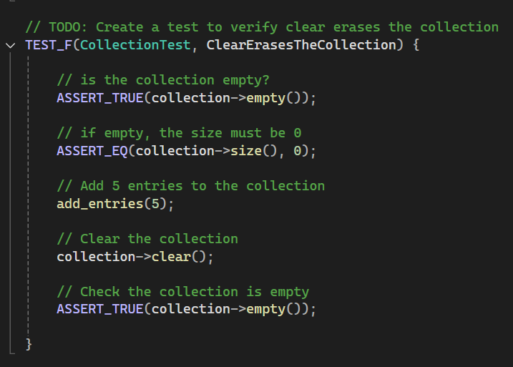
Does .clear() erase the collection?
Notes:
The first two are positive tests.
This test confirms that calling .clear() on the vector removes all elements from the collection. This ensures that the collection can be emptied when needed.
Asserts are used to check that the collection is empty and size is 0. Five entries are added, then .clear() is called. Finally, ASSERT_TRUE is used to check that the collection is truly empty.

Slide 10
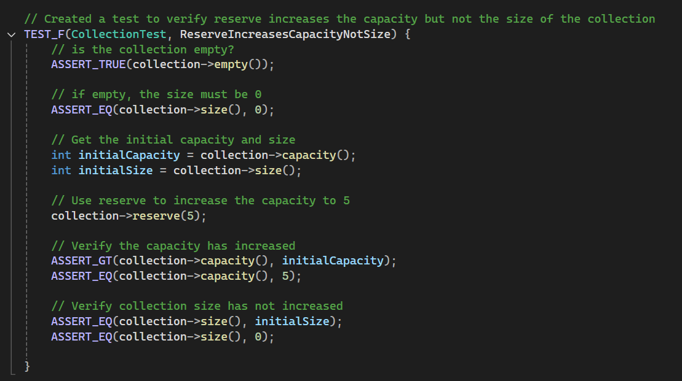
Does reserve increase capacity, not size?
Notes:
The next test verifies that calling .reserve() changes the capacity of the vector, but not the number of elements in it, showing that memory can be managed without altering the data. First the collection is confirmed to be empty, and size is 0. The initial capacity and size are stored in two variables, then .reserve() is used to increase the capacity to 5. Finally, the current capacity and size are checked against the previous ones to verify that capacity has increased but size remains the same.

Slide 11
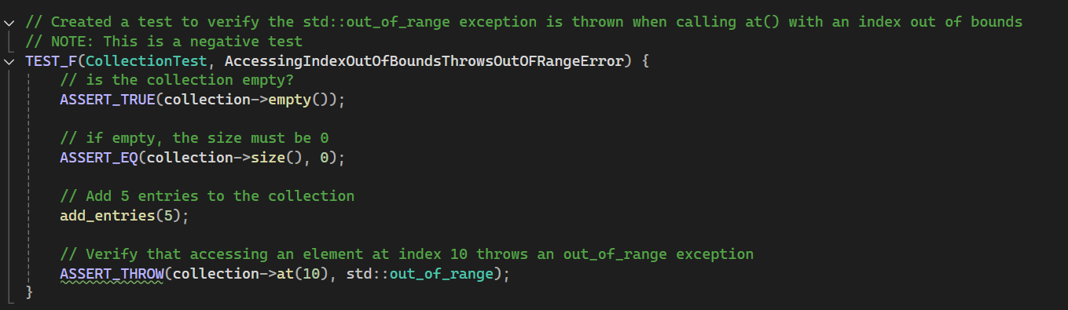
Does accessing an index out of bounds throw an out-of-range error?
Notes:
The next two tests are negative tests.
This test checks that accessing an invalid index correctly throws an exception, protecting against memory corruption or reading from an invalid index. As before, the collection is confirmed to be empty, and size is 0. Five entries are added to the collection. Then we use ASSERT_THROW to verify that accessing an element at index 10 with .at() throws an exception.

Slide 12
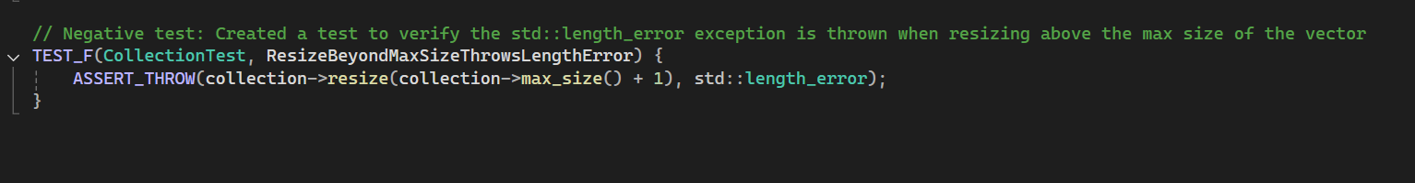
Does .resize() beyond max size throw a length error?
Notes:
This last test ensures that attempting to resize the vector beyond its maximum size throws the correct length error exception. This prevents logic errors or crashes. A single ASSERT_THROW is used to check that attempting to resize the collection to its max size plus one throws a length error.

Slide 13
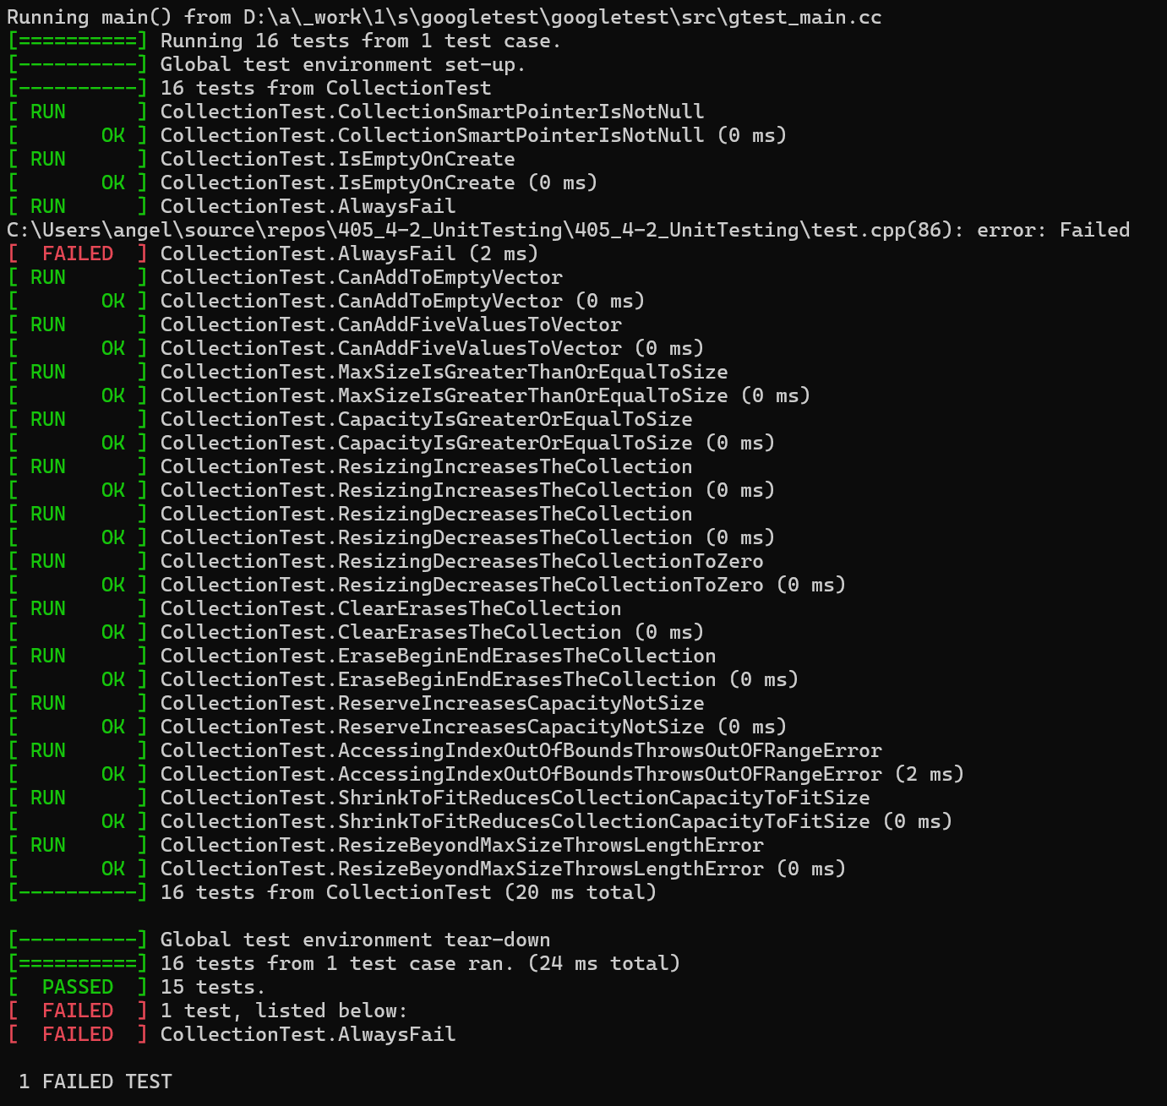
Results
Notes:
The results show all tests ran successfully, confirming proper handling of both normal operations with positive tests and error scenarios with negative tests. The selected tests are highlighted in yellow.

Slide 14

AUTOMATION SUMMARY
Notes:
This diagram shows the DevSecOps pipeline, which integrates security throughout the software development lifecycle, instead of leaving it to the end. Each stages includes manual or automated security testing in some form to ensure that vulnerabilities are detected and mitigated as early as possible.
Automation makes it easy to quickly and consistently test software using methods like scans, dependency checks, and patching to build secure software systems. It should be used throughout the entire development life cycle to ensure that security policies are consistently enforced at every stage. This approach falls under the Shift Left Security principle, which encourages applying security earlier in the development life cycle rather than leaving it to the end.

Slide 15
TOOLS
Automation and tools complement human testing and manual reviews
Static Application Security Testing (SAST) tools - Cppcheck
Scanning tools
Monitoring and detecting tools
Response automation
Active Directory and LDAP automation
Notes:
Automation reduces human error and can catch vulnerabilities that developers may miss. However, it does not detect every error, such as “STD-003-CPP: Guarantee that storage for strings has sufficient space for character data and the null terminator.” Automation must be used to complement human testing and code reviews rather than replacing them, following the Defense in Depth principle.
Automation can be used in the Design and Build stages of DevSecOps by choosing automation tools according to the company’s coding standards to enforce policies and guide developers as they write code. Static Application Security Testing (SAST) tools like Cppcheck can help enforce standards and find vulnerabilities early. In the Verify and Test stage, vulnerability scanning tools can find weaknesses before deployment. Automation can also be helpful in the Monitor and Detect stage by helping detect threats quickly, and it can even automate responses to common threats.
Active Directory (AD) stores private user information, and the Lightweight Directory Access Protocol (LDAP) is a protocol for reading and modifying that user information. They can both be automated to make it easier to confirm user identity within the system, helping to implement Authentication, Authorization, and Accounting (AAA) security.

Slide 16
RISKS AND BENEFITS
Benefits of acting now include protection from attacks sooner, better reputation, client trust, ensuring that security is addressed intrinsically from the beginning of the development lifecycle, and using tools like Cppcheck to perform static analysis checks that provide style warnings, error messages, and help identify high-risk issues
Risks of acting now include implementation costs and training time, and the risk of implementing an incomplete plan
Benefits of waiting include having more time to craft a complete plan, create a budget of both time and money, and implement the plan more responsibly
Risks of waiting include becoming a target before the plan is in place. For example: Nova Scotia Power scheduled their security plan for December 2025 but were attacked nine months earlier (Bousquet & Henderson, 2025)
The first standards to implement should focus on protecting against code injection and memory allocation errors
Notes:
Acting now allows us to put secure coding at the forefront of our projects, addressing security intrinsically instead of leaving it to the end. For example, we can use static analysis tools like Cppcheck to scan code as we write it. This will protect our software from attacks that could cost more time and money to fix, while also risking client trust. Acquiring automation tools and learning new testing methods will require some upfront costs, but these will be good investments.
On the other hand, if we wait, we could design and implement a more complete plan and properly allocate time and money for acquiring high-quality tools and training. However, there are also risks to waiting.
An example of a company that waited to implement their security plan is Nova Scotia Power. In fact, their security plan barely mentioned protecting against data breaches and instead focused more on defending against cyberattacks on their critical infrastructure, like power plants and substations. The plan was to be implemented by December 2025, but they were the victim of a ransomware attack in mid-March of that year, nine months earlier. Sensitive customer data, like names, contact information, banking details and Social Insurance Numbers, was stolen, held for ransom, and later published on the dark web (Bousquet & Henderson, 2025). We should learn from this example and act now before one of our systems becomes a target.
We should prioritize protecting against code injection and memory allocation errors first, as these have the highest risk of introducing serious vulnerabilities.

Slide 17
RECOMMENDATIONS
Principle 5 (Default Deny), and Principle 6 (Adhere to the Principle of Least Privilege) do not currently have standards aligned to them.
Current code does not have standards or policy for Principle of Least Privilege or Default Deny
There is currently no schedule or roadmap for implementation or training
A budget must be outlined, and decisions must be made on which tools to acquire and learn
Notes:
This policy is a good first step towards implementing coding standards that prioritize testing and security, yet there are still gaps in the policy. For example, although there are 10 principles and 10 coding standards, two principles are not mapped to any coding standards: Principle 5 (Default Deny) and Principle 6 (Adhere to the Principle of Least Privilege). This means that we lack standards to enforce Default Deny and Least Privilege, which are important for preventing unauthorized access. This leaves us vulnerable to malicious actors that may gain access to our systems by leaving systems unnecessarily open, instead of restricting access by default and granting only the minimum privileges required.
Additionally, we must plan a schedule and budget for the tools and training necessary to follow the policy successfully.

Slide 18
CONCLUSIONS
Standards to adopt:
ENV33-C. Do not call system() (SEI CERT C++ Coding Standard, n.d.)
MSC41-C. Never hard code sensitive information (SEI CERT C++ Coding Standard, n.d.).
An example of what could happen if we do not adopt these standards is the 2013 Target data breach, where attackers gained access through third-party vendor credentials, exploited elevated privileges, and stole 40 million credit and debit card numbers (Jones, 2025)
Notes:
Some standards we should adopt that map to Default Deny and Least Privilege include:
ENV33-C. Do not call system(): Although written for C, it applies to C++ as well. Calling system() with an unsanitized command string on a system with elevated privileges could allow an attacker to execute damaging system commands (SEI CERT C++ Coding Standard, n.d.)
MSC41-C. Never hard code sensitive information: This C standard also applies to C++. If we follow this standard, our sensitive data, like encryption keys, remain hidden in the event of a breach, adding an extra layer of protection (SEI CERT C++ Coding Standard, n.d.).
A real-world example of why we should adopt these standards is the 2013 Target data breach. Attackers gained access through a third-party HVAC vendor, who was itself the victim of a phishing attack. Using stolen vendor credentials, the criminals were able to access the Target web application. Because the vendor account had elevated privileges within the Target system, and Target’s network lacked segregation and Default Deny protections, the criminals were able to move laterally within the network and plant malware on point-of-sale systems, stealing 40 million credit and debit card numbers along with customer data (Jones, 2025).

Slide 19
REFERENCES
Bousquet, T., & Henderson, J. (2025, May 30). Nova Scotia Power saw the potential for a cyber attack, but did too little too late. Halifax Examiner. https://www.halifaxexaminer.ca/morning-file/nova-scotia-power-saw-the-potential-for-a-cyber-attack-but-did-too-little-too-late/
Jones, C. (2025, July 1). Warnings (& lessons) of the 2013 Target data breach. Red River. https://redriver.com/security/target-data-breach
SEI CERT C++ Coding Standard. (n.d.). SEI CERT C++ coding standard. https://wiki.sei.cmu.edu/confluence/display/cplusplus/
Notes:
This last slide shows my references for this presentation. Thank you for listening and watching.

